Slide 1
Survival Prediction of Heart Failure Patients: A Machine Learning Approach
An Overview of Stacked Ensemble Machine Learning Algorithm

Slide 2
Introduction
Heart failure is a critical global health issue with high mortality rates.
Accurate survival prediction can significantly improve treatment and management.
Machine Learning (ML) offers advanced tools for predictive analysis in healthcare.
This study explores a stacked ensemble ML algorithm for survival prediction.

Slide 3
Problem Statement
Cardiovascular diseases are the leading cause of death globally.
Heart failure survival prediction remains a challenging task due to complex factors.
Traditional statistical methods lack the nuanced analysis provided by ML models.

Slide 4
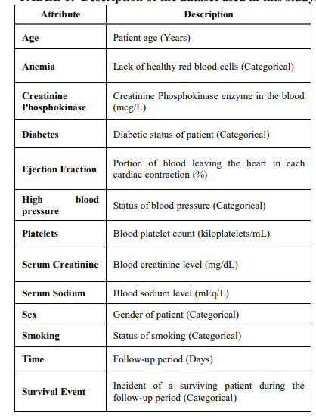
Dataset Overview
The study utilizes a dataset of 300 heart failure patients.
Includes 12 clinical features like age, anaemia, creatinine levels etc.
The target variable is “Survival Event” indicating patient survival.

Slide 5
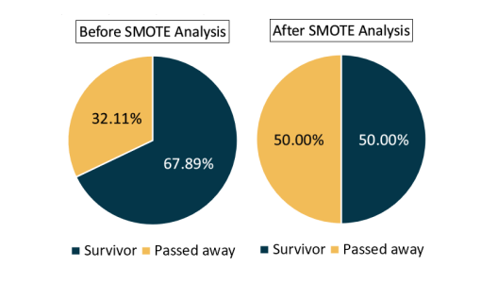
Preprocessing and SMOTE
Data preprocessing included cleaning and normalization.
SMOTE (Synthetic Minority Over-sampling Technique) used to address class imbalance.
Enhanced the model's ability to learn from minority class.

Slide 6
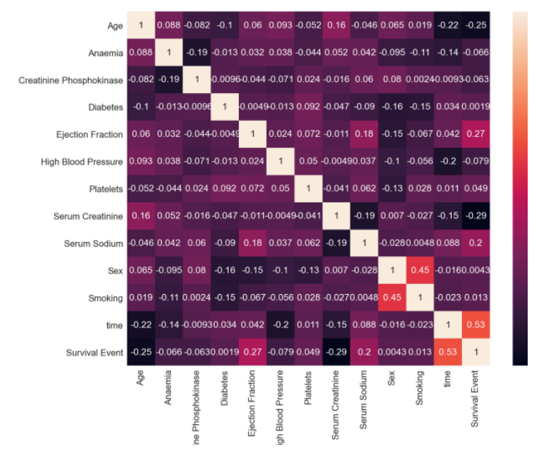
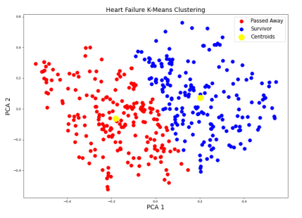
Machine Learning Algorithms Used
Unsupervised learning: K-Means and Fuzzy C-Means clustering to understand data patterns.
Supervised learning: Random Forest, XGBoost, Decision Tree for prediction.
Ensemble methods improve predictive performance.

Slide 7
Stacked Ensemble Architecture
Combines multiple machine learning algorithms for enhanced prediction.
Uses a meta-learner to integrate predictions from base learners.
Aims for higher accuracy than any single model.

Slide 8
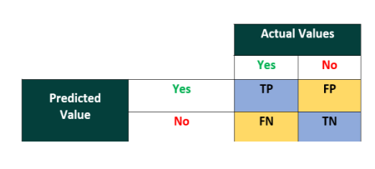
Performance Evaluation Metrics
Metrics used: Accuracy, Precision, Recall, F1-Score.
Confusion matrix for evaluating model performance.
Balanced evaluation considering both precision and recall.

Slide 9
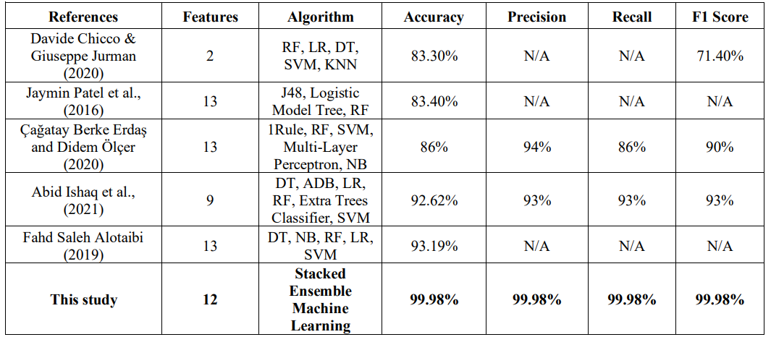
Results and Discussion
Stacked ensemble model outperformed individual models.
Demonstrated high accuracy and F1-score in survival prediction.
Potential for clinical application in heart failure management.

Slide 10
Conclusion and Future Work
The stacked ensemble model shows promise in heart failure survival prediction.
Can assist healthcare professionals in decision-making.
Future work includes model refinement and real-world testing.

Slide 11
References
Research paper : https://arxiv.org/ftp/arxiv/papers/2108/2108.13367.pdf

